Slide 1
Week 1 – Lab B Input Validation Techniques

Slide 2



Outline
Validation via While loops
Validation via Scanner methods
Sentinel Values

Slide 3
Input Validation
As we’ve been developing our programs, we’ve been assuming the users will always supply us with the correct type of inputs
We should ideally anticipate that users will enter incorrect input - either intentionally or accidentally - and provide mechanisms to validate this input
Let’s take a look at one of the most simplest approaches – using a while loop
Example: Validating an integer input (e.g. age)
Validation: While Loops
Validation: Scanner Methods
Sentinel Values

Slide 4
VALIDATION VIA WHILE LOOPs
Validation: While Loops
Validation: Scanner Methods
Sentinel Values

Slide 5
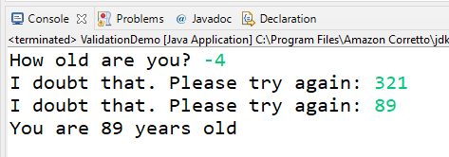
import java.util.Scanner;
public class ValidationDemo {
public static void main(String[] args) {
// program: ask user for age and print if it’s a sensible value
Scanner input = new Scanner(System.in);
System.out.print("How old are you? ");
int age = input.nextInt();
while (age < 0 || age > 130) {
System.out.print("I doubt that. Please try again: ");
age = input.nextInt();
}
// when we get to this point, the age will be a valid int
System.out.println("You are " + age + " years old");
input.close(); // close scanner
}
}
Import Scanner class
Create scanner object
Prompt user for age
Store initial input in age variable
While input is invalid, keep prompting user
Validation: While Loops
Validation: Scanner Methods
Sentinel Values

Slide 6

Validation via Scanner methods
Validation: While Loops
Validation: Scanner Methods
Sentinel Values

Slide 7
Scanner hasNext() Methods
The Scanner class has useful methods for testing whether the next input will succeed
E.g. the hasNextInt() method returns true if the next token is an integer. It is a good idea to call this method before calling nextInt()
There are hasNext methods for other data types – e.g. hasNextDouble(), hasNextFloat()
while( input.hasNextInt() ) {
int number = input.nextInt();
//...
}
Validation: While Loops
Validation: Scanner Methods
Sentinel Values

Slide 8
Scanner hasNext() Methods
The hasNext methods do not pull anything from the input stream – they only take a “peek” at what is there and report back to us a boolean (true or false)
Let’s look at an application which utilises these types of methods
Application: User will enter their age, and provided an integer is the next token in the input stream, we will retrieve it and print it
Validation: While Loops
Validation: Scanner Methods
Sentinel Values

Slide 9
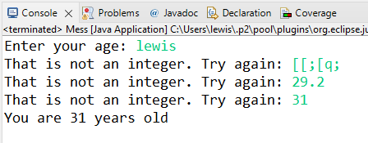
import java.util.Scanner;
public class ValidationDemo {
public static void main(String[] args) {
int age; // declare age as int
Scanner input = new Scanner(System.in);
System.out.print("Enter your age: ");
// while user has not (!) typed in an integer
while (!input.hasNextInt()) {
System.out.print("That is not an integer. Try again: ");
input.nextLine(); // clear the input stream so they can try again
}
age = input.nextInt();
System.out.println("You are " + age + " years old");
input.close();
}
}
Declare age variable
Prompt user for initial input
While next token is not an integer
Need to remove the incorrect input they just typed in – referred to as ‘flushing the scanner’
If we get to this point, the next token is an integer, so fetch it and store it in age variable
Validation: While Loops
Validation: Scanner Methods
Sentinel Values

Slide 10
Sentinel Values
Validation: While Loops
Validation: Scanner Methods
Sentinel Values

Slide 11
Sentinel Values
A sentinel value is a value which is used to signal “end of data entry”
Typically used in conjunction with a while loop – and when a person enters this sentinel value we exit the loop and continue with the rest of the program
A sentinel value is used solely to indicate it is the end of data entry and is not part of the data itself
Let’s take a look at this might work with an example program:
Application: Accept integers from the keyboard corresponding to student grades. When the user types -1 that will signal the end of the grades and we can continue with calculating and printing the average
Note: There is nothing special about -1 (You can come up with your own sentinel value)
Validation: While Loops
Validation: Scanner Methods
Sentinel Values

Slide 12
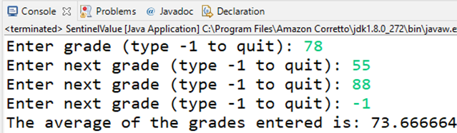
// assume we are in a class, with a main method, and that Scanner has been imported
Scanner input = new Scanner(System.in);
int total = 0; // keep track of the running total
int numGrades = 0; // keep track of num of grades typed in
float average; // to be calculated later
System.out.print("Enter grade (type -1 to quit): ");
int grade = input.nextInt(); // fetch input
while (grade != -1) { // while sentinel value has not been entered
total = total + grade; // increase total by grade (could also do total += grade)
numGrades++; // increase numGrades by 1
System.out.print("Enter next grade (type -1 to quit): ");
grade = input.nextInt();
}
average = (float) total / numGrades;
System.out.println("The average of the grades entered is: " + average);
total and numGrades are both ints. Dividing one int by another does not produce fractional part – so need to cast one to float (could also declare either as a float)
Validation: While Loops
Validation: Scanner Methods
Sentinel Values

Slide 13

Summary
Several ways to validate user input
While loops – simple and effective, but do not work well in some cases
E.g. validating an integer is input is between a certain range will only work if the user is supplying integers
Scanner hasNext() methods – robust methods which take a ‘peek’ at the next token and returns a boolean
E.g. hasNextInt() will return true if the next token to be fetched is an integer, false otherwise
Sentinel values – values which can be entered by a user to signal they have finished entering data
Validation: While Loops
Validation: Scanner Methods
Sentinel Values

